Slide 1



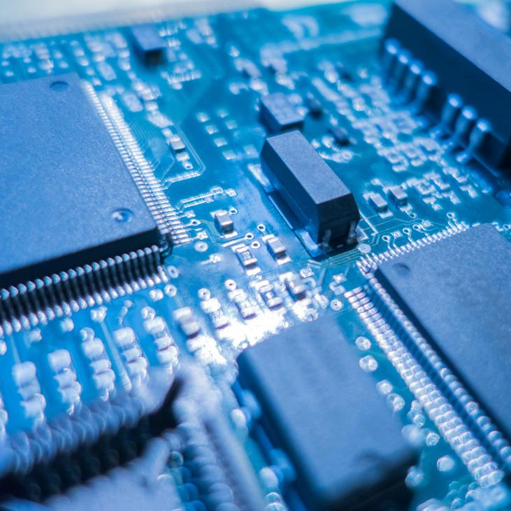
October 2021
UNIVERSITY OF TORONTO FINTECH BOOTCAMP
COVID Market Trends
Comparative analysis of major market trends Vs. Cryptocurrency
Sadia Akbar
Benjamin Weymouth Mohamed Berrachdi

Slide 2
Motivation and Summary
MOTIVATION
SUMMARY
QUESTIONS
Our motivation is to understand how the covid pandemic affected market trends, volatility and correlations between various market forces in cryptocurrencies, commodities and the semiconductor industry.
We will address the connection between cryptocurrencies, the covid pandemic, and various X-Factors: semiconductors, meme stocks and gold.
We sought to uncover the answer to these questions:
Is there a correlation between the performance of our X-Factor, cryptocurrency and the covid crisis?
If an investor had a choice, should they have invested in an X-Factor or in cryptocurrencies based on pre and post covid performance?
Notes:
Speaker: Ben

Slide 3
Questions & Data
Data: Yahoo Finance
WHO Covid-19 Data
Other Sources
For our cryptocurrency, gold and the semiconductor industry analysis, we utilized Yahoo Finance. We looked at other commodities on finance but narrowed our scope and gained some momentum.
For our data on the covid crisis, we turned to an internationally recognized body, the World Health Organization. We were able to find csv data on covid case numbers.
We utilized other sources initially like coinmarketCap and GeckoCoin API. Neither of these sources were helpful in the end due to their restrictive licencing. However it was a learning process and we are more skilled with APIs and JSON calls.
Notes:
Speaker: Ben

Slide 4
Data structuring Timeline
Pre Covid era
Start of Covid
Post Covid period
March 2018
March 2020
June 2021
Investments are classic
Classic investors are Institutional
Crypto Currency is still a novelty to the average investor due to their technical sophistication and lack of access
Shift in the composition of Income
Shift of the income structure
Rise of the retail investment powered by Fintech powered Robo Advisors and investment apps (Robinhood, Wealthsimple, QuestTrade, Gemini … ect
Adoption of Crypto by the larger public and start of adoption
Fade of the “Get-Rich-Schemes” and adoption of more solid investment solutions
Notes:
Speaker: Mo We sliced our periods based on 3 factors, we pulled data 2 years before March 2020 or the start of Covid and March 2020 to June 2021 when Covid cases number dropped globally.

Slide 5
Data Cleanup & Exploration
Exploration and cleanup
Problems / Insights
Interesting Findings
We each began with data from yahoo finance, and we removed null values, duplicates and sorted the data.
Initially we did have problems with the WHO data because there were so many fields. We ended up removing a number of columns. The Yahoo data was quite clean and required very little in terms of clean-up.
We found the WHO data to be quite interesting and showed the staggering number of cases, cumulative cases and deaths. The stark and steady increase was much different from the volatility found in the financial markets.
Notes:
Speaker: Sadia

Slide 6
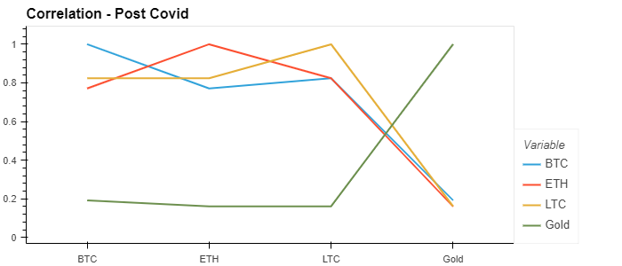
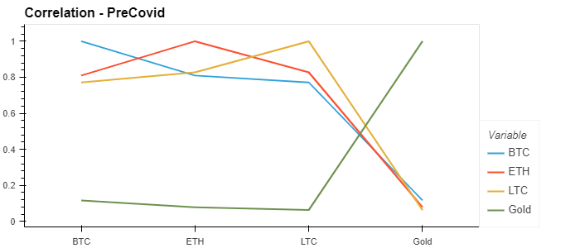
Data: Interesting Figures
Gold vs Cryptocurrencies
Notes:
Speaker: Sadia
During our analysis, we noticed the parameters changing drastically as each of the cryptocurrencies outperformed Gold in terms of positive cumulative returns, considering which we would assume, there would have been some changes or disturbances in the correlation between crypto and gold, however, as we can see through the graphs presented there is no visible difference between the correlation before and after Covid of the cryptocurrencies and gold.

Slide 7
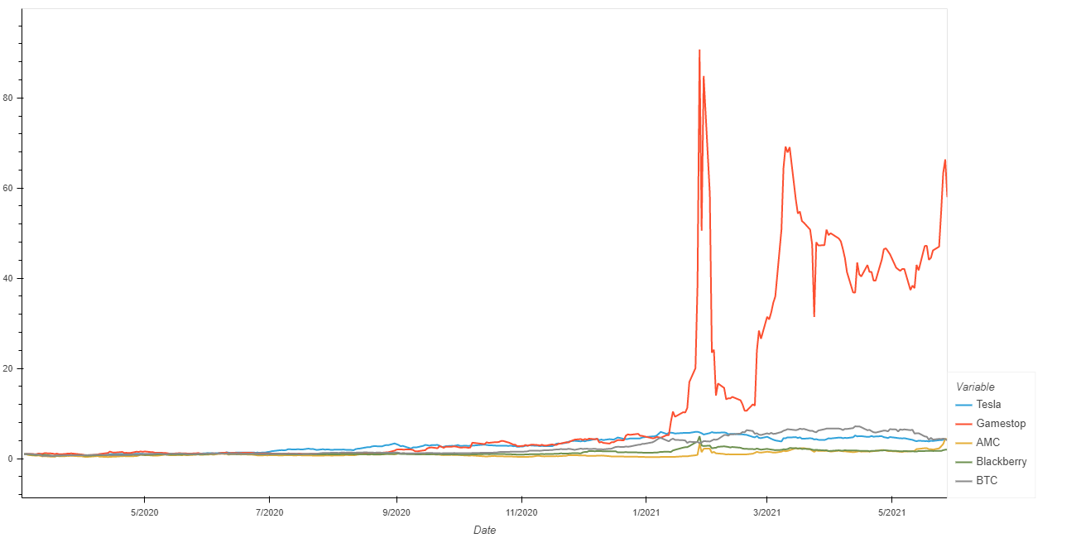
Data: Interesting Figures
Meme Stocks Vs. Crypto
Cumulative Returns
Notes:
Speaker : Mo The peak of GME as a one in market history occurrence

Slide 8
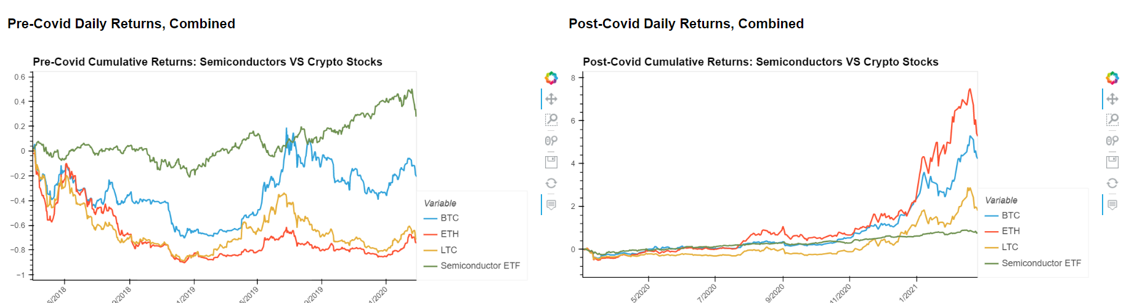
Data: Interesting Figures
Semiconductors and Crypto: before and after
Notes:
Hypothesis: While these two industries are disparately different, they are intricately linked. If the semiconductor ETF goes up due to scarcity in the covid era, then it may be that the cryptocurrency prices will rise accordingly. Before: we see a high correlation between semiconductors and cryptocurrencies. After- shortage in chips lead to decline where market efficiency had been achieved by crypto. No longer an emerging market.

Slide 9
Team Dashboard: on Bokeh Server

Slide 10
Data Analysis: Answers
Meme Stocks
Gold
Semiconductors
Crypto in General and Bitcoin in particular are known in the market as the most volatile assets; during Covid and the rise of the Meme Stocks frenzy, we witness very sharp volatility which started towards the end of 2020 and continued towards the end of june 2021 with peaks in GME, AMC and Bitcoin throughout that phase.
Our analysis of the pre and post covid era showed us that the behaviour of the cryptocurrencies significantly changed in the latter half of 2020, when the pandemic continued to settle globally, with the cryptocurrencies significantly performing better surpassing gold in term of returns.
My question was which one fared better. A detailed analysis was executed, and it was shown that the semiconductor market actually fared well over the covid pandemic. While semiconductors were not the biggest in terms of returns, it was less volatile than the three cryptocurrencies under analysis.
Notes:
Speaker: Sadia
Meme stocks = we witness very sharp volatility which started towards the end of 2020 and continued towards the end of june 2021 with peaks in GME, AMC and Bitcoin throughout that phase.
Gold = behaviour of the cryptocurrencies significantly changed in the latter half of 2020, when the pandemic continued to settle globally, with the cryptocurrencies significantly performing better surpassing gold in term of returns.
SEMI = was shown that the semiconductor market actually fared well over the covid pandemic. While semiconductors were not the biggest in terms of returns, it was less volatile than the three cryptocurrencies under analysis.

Slide 11
Conclusions
Meme Stocks
Gold
Semiconductors
Results from the graph show that although some investors managed to pull substantial gains from investments in meme stocks if they bought in very early and sold in the right time, but the timing or catching the market is more based on circumstantial conditions rather than founded ones, if we compare the pre and post covid data we can see the volatility that characterized the meme stock.
Findings and patterns suggest little to no correlation between covid cases and gold prices. But where gold remained stable and least volatile, cryptocurrencies, specifically BTC benefitted from the pandemic, with prices skyrocketing in comparison to not only gold, but other cryptocurrencies as well.
Covid cases have a direct correlation to semiconductor prices. And semiconductors are directly correlated to the price of mining cryptocurrencies. Thus, if there is any slow down or shortage to semiconductor production, it is reasonable to expect that there may be some impact on the cryptocurrency market.

Slide 12
Post-Mortem
Difficulties
Questions
More time / the future
At the beginning of the group work we faced difficulties with our API’s not working and we had to switch our data sources. It took some time to find a new data source but we found finance, a new library that we had not discussed in class.
We did have some unsolved issues due to github pull/push issues which we did solve and developed a good system for tracking changes using GitKraken.
We would research more numeric analysis up to the present day, and if we had more time we would add more simulations, such as a Monte Carlo simulation.

Slide 13


Do you have any questions?

